Slide 1

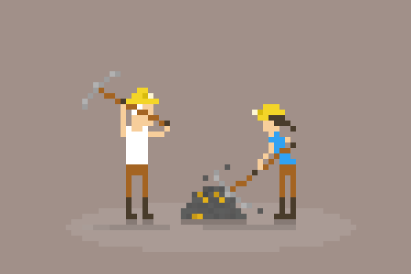
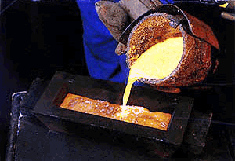

Slide 2
DATA PREPROCESSING USING PYTHON
Team_pyCrastinators

Slide 3
Python Packages and Tools
Pandas
Scikit Learn
Numpy
SciPy

Slide 4
Steps of Data Preprocessing
Data cleaning
Data integration
Data transformation
Discretization

Slide 5
Data Cleaning
Drop tuples with missing data(*)
Mean Substitution
Mode Substitution
Median Substitution
Replace with frequent values

Slide 6
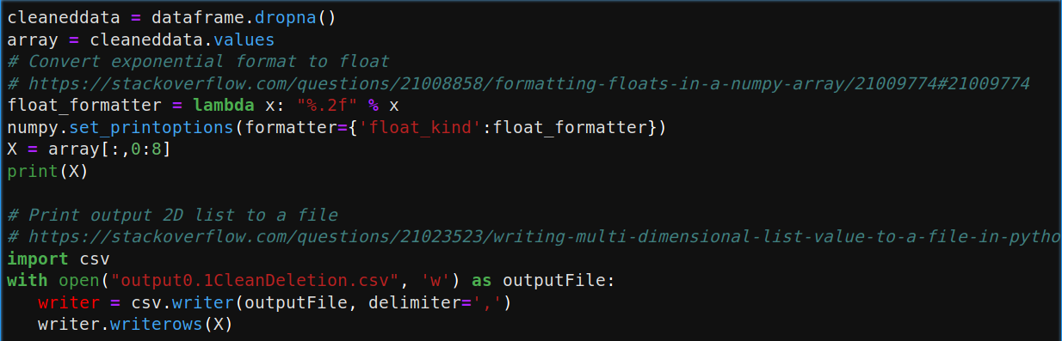
Drop tuples with missing data(*)

Slide 7
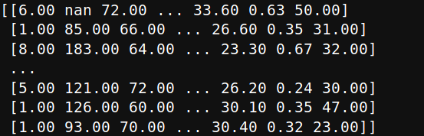
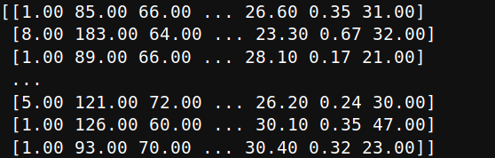
Drop tuples with missing data(*)
|
V

Slide 8
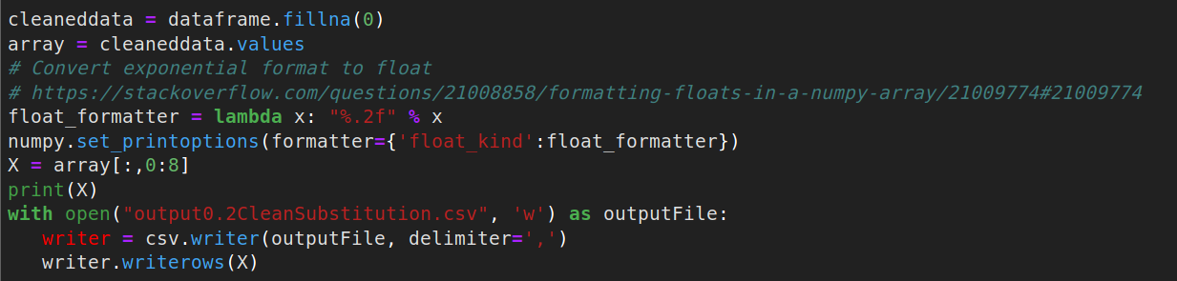
Replace with a fixed value

Slide 9
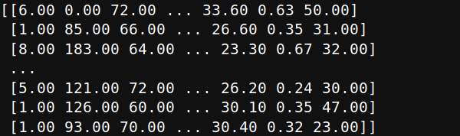
Replace with a fixed value
|
V

Slide 10
Data Transormation
1. MinMax Scaling
2. Standardization
3. Normalization
4. Binarization

Slide 11
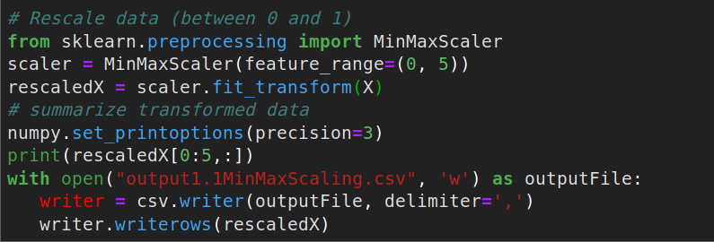
MinMax Scaling

Slide 12
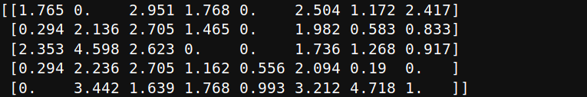
MinMax Scaling
|
V

Slide 13
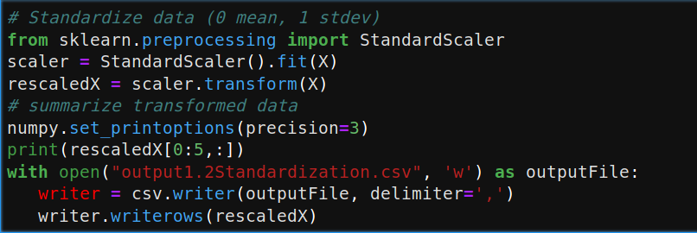
Standardization

Slide 14
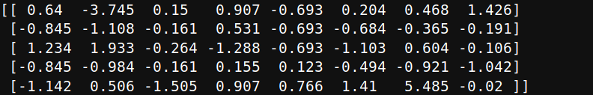
Standardization
|
V

Slide 15
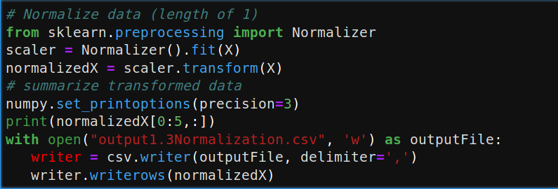
Normalization

Slide 16
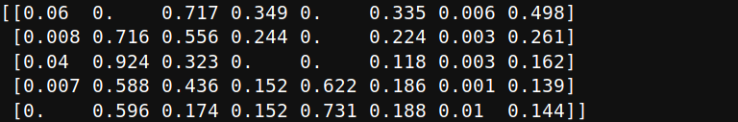
Normalization
|
V

Slide 17
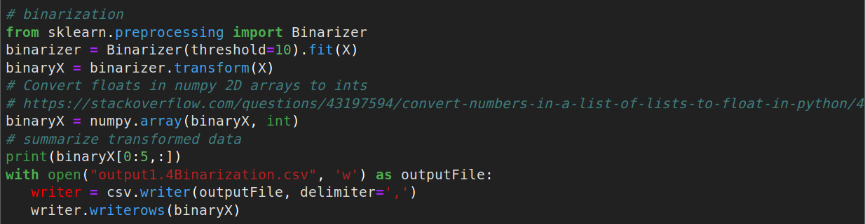
Binarization

Slide 18
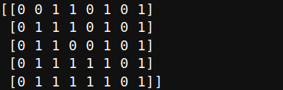
Binarization
|
V

Slide 19
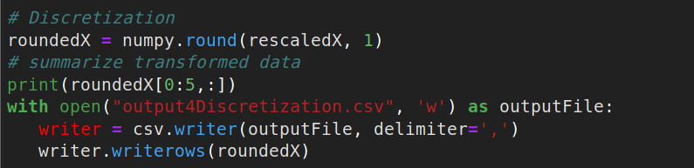
Discretization

Slide 20
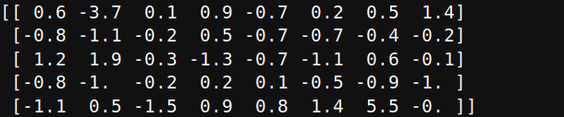
Discretization
|
V

Slide 21
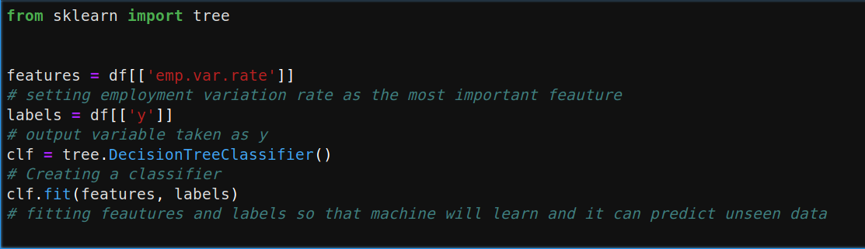
Prediction

Slide 22
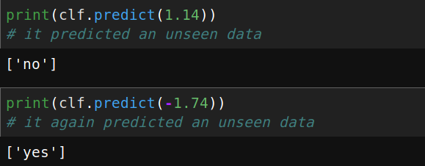
Prediction

Slide 23
Thanx!

